Slide 1
MVN Setup
Download maven from apache official site "https://maven.apache.org/"
Ensure JAVA_HOME environment variable is set and points to your JDK installation
1> Right Click on My Commuter ICON => Select properties => Advanced system settings => Advanced => Environment variables =>
Create below System variable
JAVA_HOME=C:\Program Files\Java\jdk1.8.0_121
2> Create below User variable
PATH=%JAVA_HOME%\bin
Extract distribution archive in any directory
And set the below Paths as described above
1>Create below System variable
M2_HOME=C:\Program Files\Apache Software Foundation\apache-maven-3.3.9
2>Create below User variable
PATH=%JAVA_HOME%\bin;.;%M2_HOME%\bin;.;

Slide 2
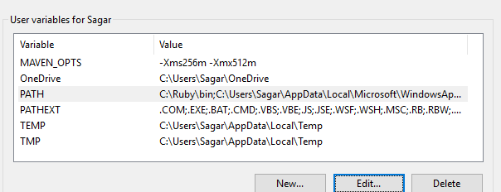
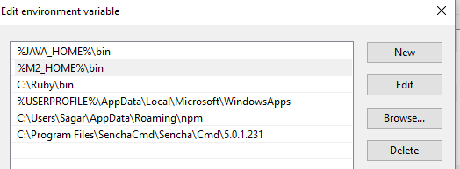
Set Maven and Java Paths as below

Slide 3


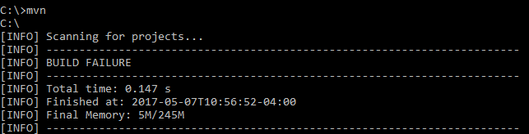
Test maven and javausing below commands

